Slide 1
Getting familiar with ACM Contest

Slide 2
What is ACM
ACM: Association for Computing Machinery
http://www.acm.org/
the world’s largest educational and scientific computing society
ACM ICPC
ACM International Collegiate Programming Contest
http://en.wikipedia.org/wiki/ACM_International_Collegiate_Programming_Contest

Slide 3
ACM ICPC
ICPC is a competition among teams of students representing institutions of higher education.
Teams compete in Regional Contests, from which top scoring teams advance to the ACM-ICPC World Finals.
Each team has three students, sharing one computer, given a number of programming problems
Coordination and teamwork are essential

Slide 4
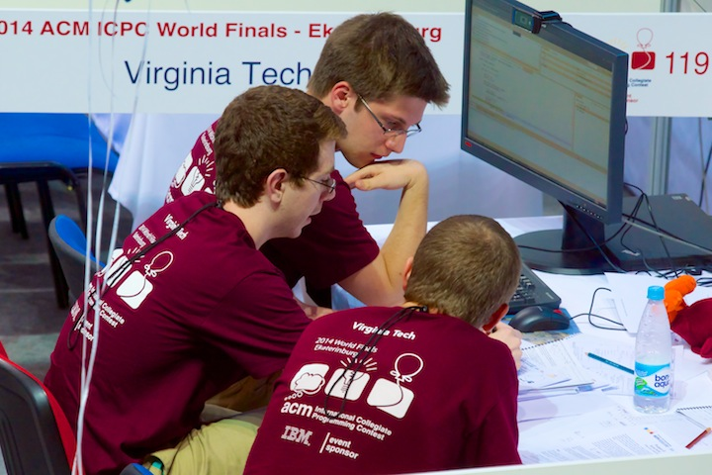
ACM finals 2014 Hosted by Ural Federal University, Ekaterinburg, Russia

Slide 5
ACM finals 2014 Hosted by Ural Federal University, Ekaterinburg, Russia

Slide 6
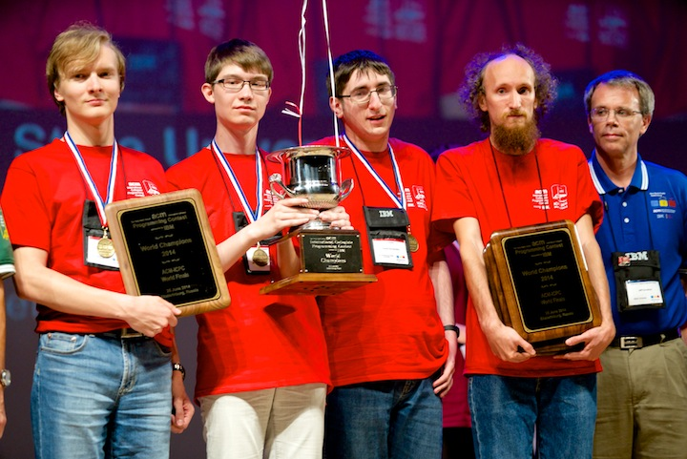
ACM finals 2014 winners
St.Petersburg State University Team
7 problems solved / 12 problems
Cup + prizes
+ a work placement and a job offers from IBM and other companies

Slide 7
Programming Languages and Judge
You can use:
C, C++, Java and others such as: Python, C#
Online Judge
Feedback :
Accepted (AC) – congratulations!
Presentation Error (PE) – Your program outputs are correct, but are not presented in the specified format. Check for spaces, left/right justification, line feeds, etc.
Wrong Answer (WA) – Your program returned an incorrect answer to one or more of the judge’s secret test cases
Compile Error (CE) – The judge’s compiler cannot compile your source code
Runtime Error (RE) – Your program failed during execution due to a segmentation fault, floating point exception, or others.
Time Limit Exceeded (TL) – Your program took too much time on at least one of the test cases. Try to improve the efficiency of your solution!
Memory Limit Exceeded (ML) – Your program tried to use more memory than the judge’s settings.

Slide 8
Available Online Judges
Famous online judges
Valladolid OJ (http://acm.uva.es/p)
Ural OJ (http://acm.timus.ru)
Saratov OJ (http://acm.sgu.ru)
ZJU OJ (http://acm.zju.edu.cn)
ZJUT OJ (http://acm.zjut.edu.cn)
Official ACM Live Archive (http://cii-judge.baylor.edu/)
Peking University Online Judge (http://acm.pku.edu.cn/JudgeOnline/)
Programming Challenges (http://www.programming-challenges.com)

Slide 9
To get ready some suggested Books
Art of Programming Contest (free online)
http://online-judge.uva.es/p/Art_of_Programming_Contest_SE_for_uva.pdf
Thomas H. Cormen, Charles E. Leiserson, Ronald L. Rivest, and Clifford Stein, Introduction to Algorithms, 2nd Edition, The MIT Press, 2001.
Robert Sedgewick, Bundle of Algorithms in Java, Third Edition (Parts 1-5), 3rd Edition, Addison-Wesley Professional, 2003. (There is also a C++ version).
Donald E. Knuth,The Art of Computer Programming, Volume 1, 2, 3.

Slide 10
Subjects
You should be familiar with:
Data Structure
Strings and Sorting
High precision arithmetic
Combinatorics and number theory
Divide and conquer & backtracking
Dynamic programming
Computational geometry
Scientific computing

Slide 11
Standard in ACM contest
Input/Output
each program must read the test data from the standard input and print the results to the standard output
For C language, use scanf() and printf()
For C++, use cin and cout
scanf() and printf() are also supported
For Java, refer to http://www.programming-challenges.com/pg.php?page=javainfo
Programs are not allowed to open files or to execute certain system calls

Slide 12
Not nice for debugging
#include <stdio.h>
int main ()
{
freopen(“FILE_NAME_FOR_INPUT”,”r”,stdin);
freopen(“FILE_NAME_FOR OUTPUT”,”w”,stdout);
Rest of the codes…
return 0;
}
While sending your code to online judges, remember to remove the two lines with freopen.

Slide 13
Things to avoid
Avoid the usage of the ++ or -- operators inside expressions or function calls
Avoid expressions of the form *p++
Avoid pointer arithmetic. Instead of (p+5) use p[5].
Never code like : return (x*y)+Func(t)/(1-s);
but like :
temp = func(t);
RetVal = (x*y) + temp/(1-s);
return RetVal;

Slide 14
Things to avoid
Naming
Don’t use small and similar names for your variables. Use descriptive names.
Don’t use names like {i,j,k} for loop control variables. Use {I,K,M}.
It is very easy to mistake a j for an i when you read code or “copy, paste & change” code,

Slide 15
Nature of problems to solve
Data structure problems
Algorithms
To solve real problems efficiently
Categories:
Sorting
Searching
Graph algorithms
Scientific computing: matrix, number-theoretic, computational geometry, etc.
-etc
Mathematics
Everything finally goes back to mathematics!
Number theory
Geometry
Combinatorics
Graph theory
…

Slide 16
Good Team
Knowing your strength and weaknesses
Knowledge of standard algorithms and the ability to find an appropriate algorithm for every problem in the set;
Ability to code an algorithm into a working program;
Having a strategy of cooperation with your teammates

Slide 17
Tips & tricks
Brute force when you can, Brute force algorithm tends to be the easiest to implement.
KISS: Simple is smart! (Keep It Simple, Stupid !!! / Keep It Short & Simple).
Hint: focus on limits (specified in problem statement).
Waste memory when it makes your life easier (trade memory space for speed).
Don't delete your extra debugging output, comment it out.
Optimize progressively, and only as much as needed.
Keep all working versions!

Slide 18
Tips & tricks
Code to debug:
a. white space is good,
b. use meaningful variable names,
c. don't reuse variables, (we are not doing software engineering here)
d. stepwise refinement,
e. Comment before code.
Avoid pointers if you can.
Avoid dynamic memory like the plague: statically allocate everything.
Try not to use floating point; if you have to, put tolerances in everywhere (never test equality)

Slide 19
Problem example Source: http://acm.zju.edu.cn/onlinejudge/showProblem.do?problemCode=1001
Time Limit:1 second Memory Limit:32768 KB
Description: Calculate a + b
Input:
The input will consist of a series of pairs of integers a and b, separated by a space, one pair of integers per line.
Output:
For each pair of input integers a and b you should output the sum of a and b in one line, and with one line of output for each line in input.
Sample Input:
1 5
Sample Output:
6

Slide 20
Solution
/* C code */
#include “stdio.h”
int main()
{
int a, b;
while (scanf(“%d %d”, &a, &b) != EOF) {
printf(“%d\n”, a+b);
}
return 0;
}
/* Java code */
import java.util.Scanner;
public class Main {
public static void main(String[] args) {
Scanner in = new Scanner(System.in);
while (in.hasNextInt()) {
int a = in.nextInt();
int b = in.nextInt();
System.out.println(a + b);
}
}
}

Slide 21
Set of problems that you can train on
Source: Fundamental Problems http://acm.zjut.edu.cn
Source: Fundamental Problems http://acm.uva.es
http://acm.uva.es/p/v1/100.html
http://acm.uva.es/p/v101/10189.html
http://acm.uva.es/p/v101/10137.html
http://acm.uva.es/p/v7/706.html
http://acm.uva.es/p/v102/10267.html
http://acm.uva.es/p/v100/10033.html
http://acm.uva.es/p/v101/10196.html
http://acm.uva.es/p/v101/10142.html
1167
1166
1174
1175
1176
1177
1178
1179
1181
1185
1190
1191
1187
1204
1208
1205
1044

